Slide 1
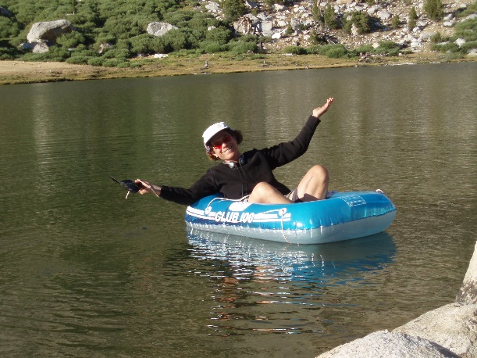
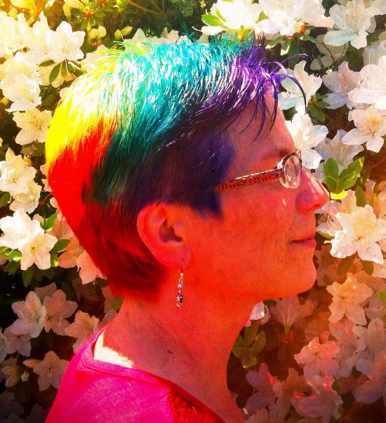


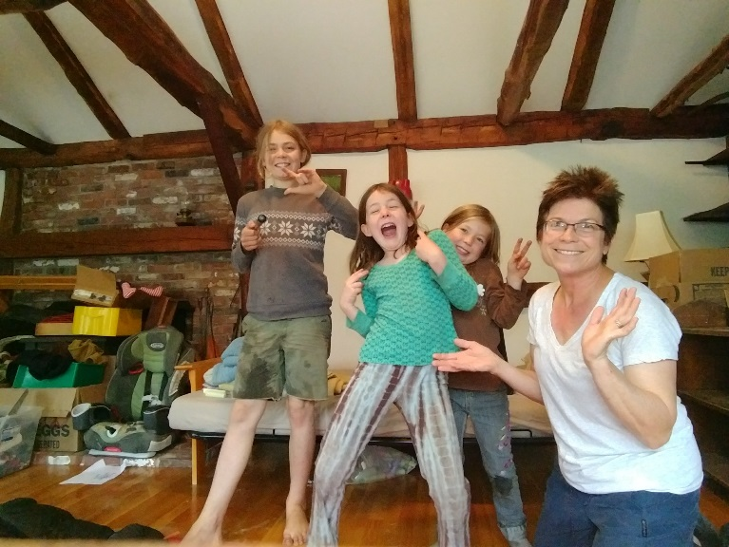
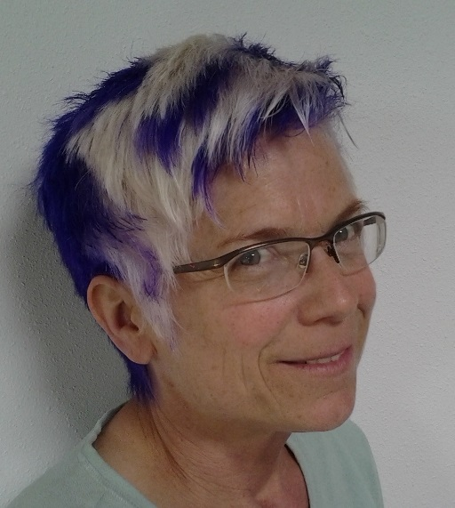

Beth Madison
bmadison@pps.net
Teacher Candidate Advocate
National Distinguished Principal
Grandma Beth
All-around fun gal

Slide 2


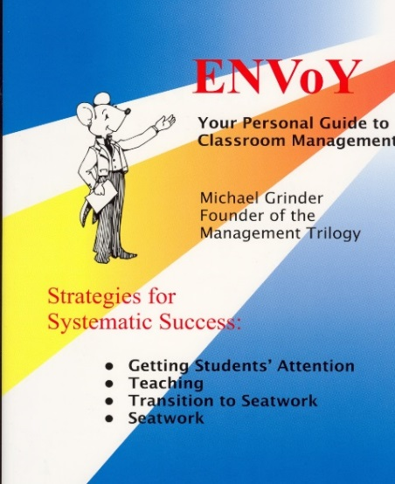
PBIS:
A proactive approach to teach, monitor and support appropriate school behavior for all students.
AVID Ready to Learn:
A schoolwide college readiness system interpreted to increase organization to improve student academic behaviors.
ENVoY Non-Verbal Classroom Management:
A vehicle to shift educators from seeing themselves
as bastions of Power to instruments of Influence.

Slide 3
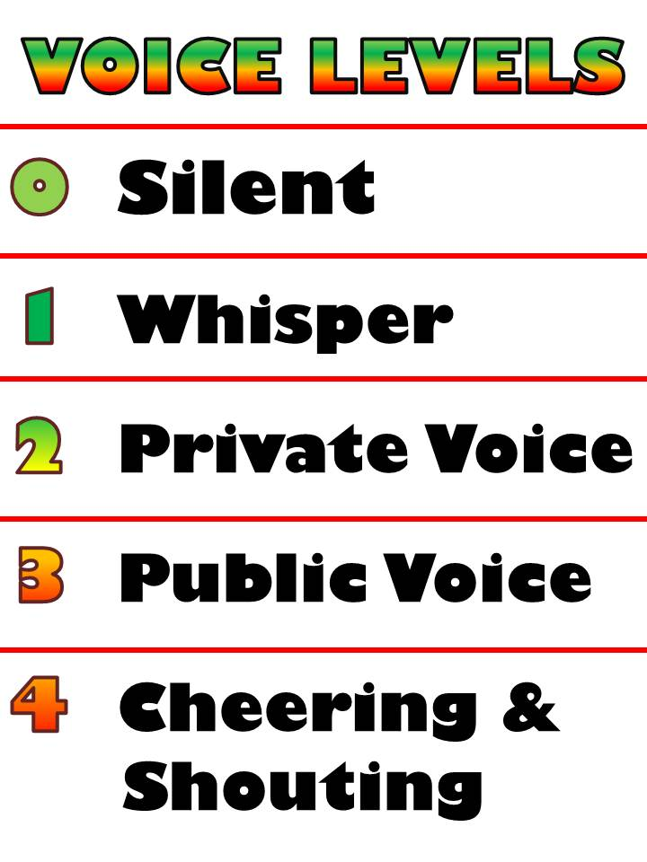
Pre-Assessment: With an elbow partner, define verbally:
Multi-tiered Systems of Support
Tier 1, Tier 2, Tier 3
DO
PUT
TIME
2 Minutes
VOICE LEVEL
WHEN DONE
Internet research

Slide 4
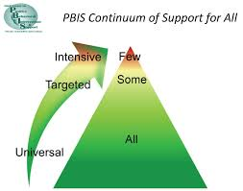
What is PBIS?
Open this link
Positive Behavior Interventions and Supports (PBIS) is a proactive approach to establishing the behavioral supports and social culture and needed for all students in a school to achieve social, emotional and academic success.

Slide 5
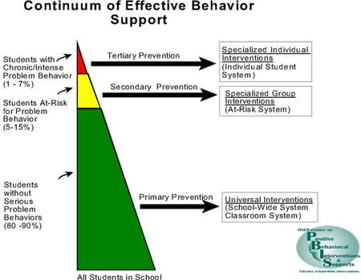
Positive Behavior
Interventions & Supports
PBIS

Slide 6
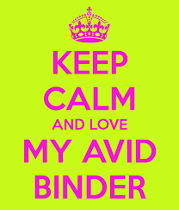
AVID
Ready to Learn
Class Time
Versus
Personal Time
“If the brain’s not buying, the brain’s not learning.” Eric Jensen

Slide 7

Advancement Via
Individual Determination
AVID
Ready to Learn
In seat, silent and working at the bell
Devices off, away & invisible
AVID Binder and all needed materials ready
Pencils sharpened, water bottle filled
Homework system in place

Slide 8
Personal Time
Use locker to store and retrieve materials
Devices use permitted
Use halls and stairs to pass to class and arrive on time (no sitting on floor, hanging out)
Take care of all personal business: bathroom, calling/texting parents, fill water bottle
Eat, drink and be merry, but not too merry
Thinking hard burns a lot of energy.

Slide 9

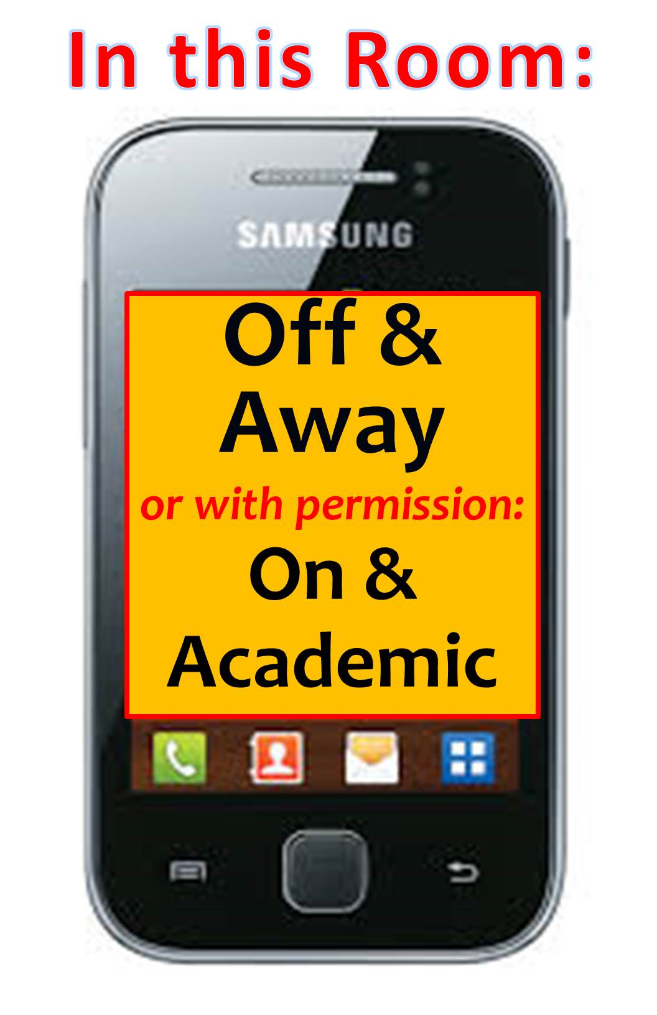

Slide 10
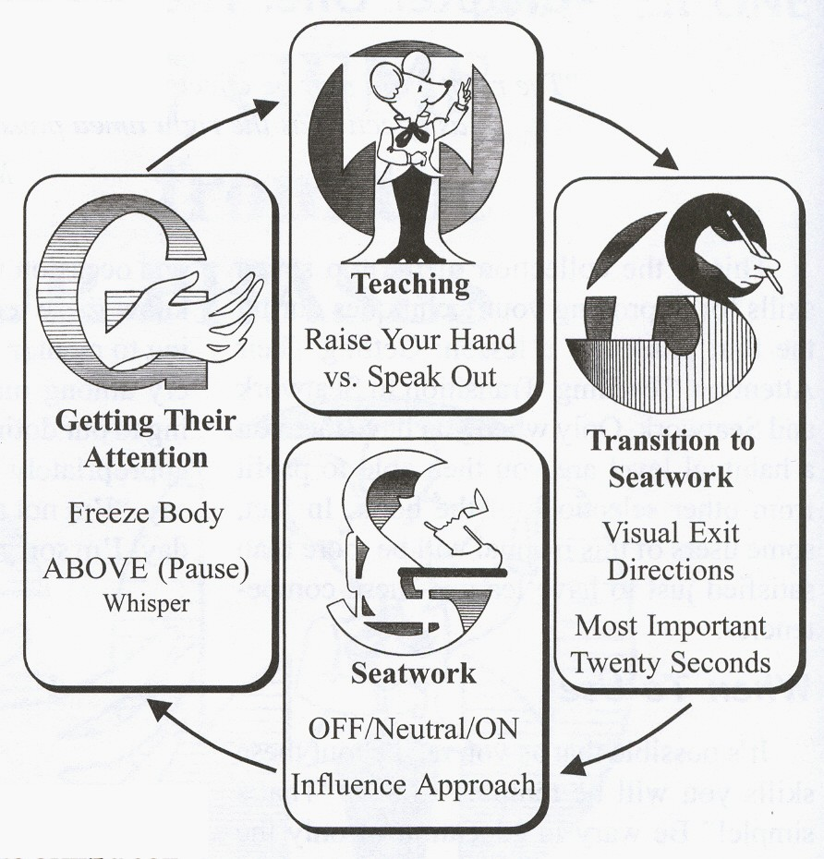
ENVoY
Non-Verbal Classroom Management
7
Gems

Slide 11
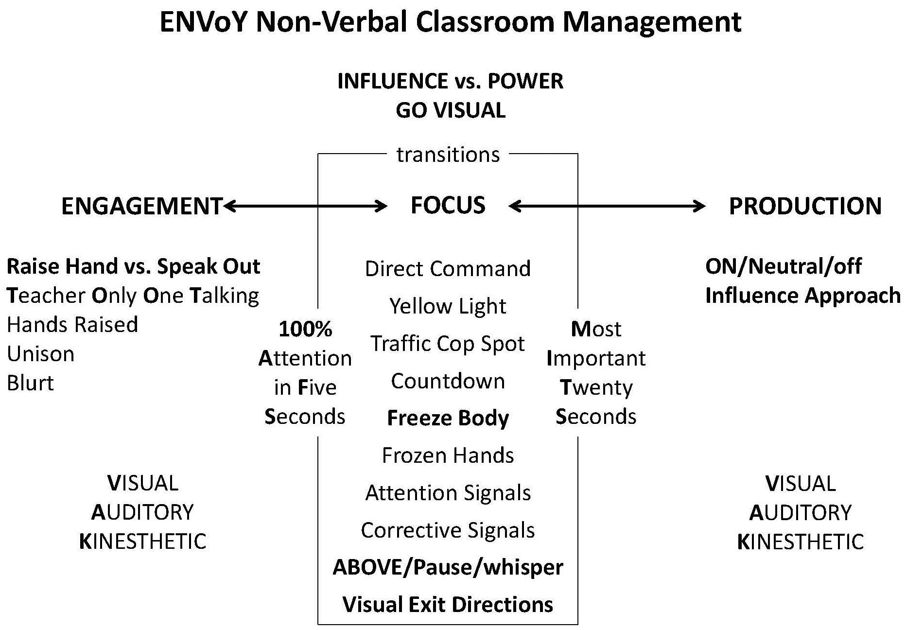

Slide 12
How Do We Recognize ENVoY?
  With “ON” days, 90% of time is
  spent on Curriculum and 10% on
  Management.
  With “OFF” days, 90% can be spent on management and only 10% on curriculum.”
Educational Binoculars
We want every day to be a 90% Curriculum Day!
Management
10%
Curriculum
90%

Slide 13
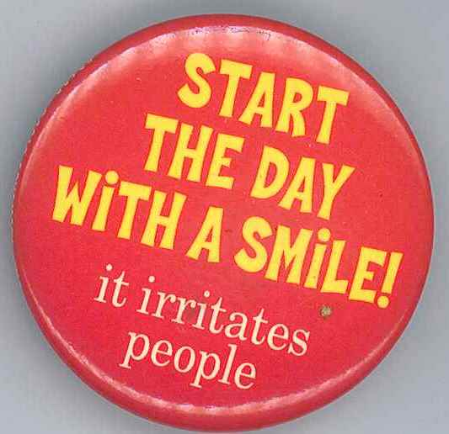

Your Demeanor &
Presentation

Slide 14


CREDIBLE
able to be believed; convincing
APPROACHABLE
friendly and easy to talk to, but…
CHARISMATIC
combination of credible & approachable

Slide 15
Leadership Style Quiz
Most people don’t know why they’re either effective or ineffective leaders. Or why they’re able to effectively lead one group but not another. Did you know there are 3 primary leadership styles? None of them are bad but knowing when to use each style is critical to effective leadership. The first step is finding out what your primary leadership style is and you can discover that by taking our Leadership Style Quiz below.
https://www.michaelgrinder.com/leadership-style-quiz/

Slide 16

Getting Their
FOCUS

Slide 17
Shhh =
the universal signal
for students to talk

Slide 18
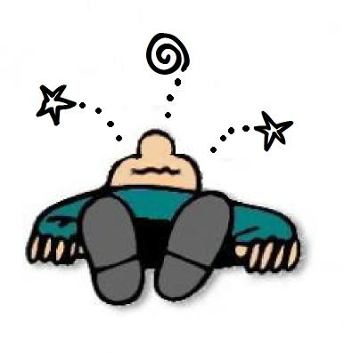
NAGGING

Slide 19

The
YELLOW
LIGHT
sing
song
voice
“Thirty seconds….”
“Ten more seconds…”
“We are almost out of time. Thumbs up if you need one more minute.”

Slide 20
The Directed
COUNTDOWN
“I need you to Do Put Get Write Sit …
In 5…
In 4… [Directive if needed]
In 3… [Directive if needed]
In 2… [Directive if needed]
In 1………………………..
repeat if
necessary,
stop ASAP

Slide 21
DO
DO
At your tables, create a poster of ways to call for class attention and what the pros and cons of them may be:
Verbals (made by people), Sounds (made by things)
Visuals (things you can show), Signals (repeated sounds, movements, etc.)
Post on the wall somewhere others can see it
12 minutes
Gallery Walk
PUT
PUT
TIME
TIME
VOICE LEVEL
VOICE LEVEL
WHEN DONE
WHEN DONE

Slide 22
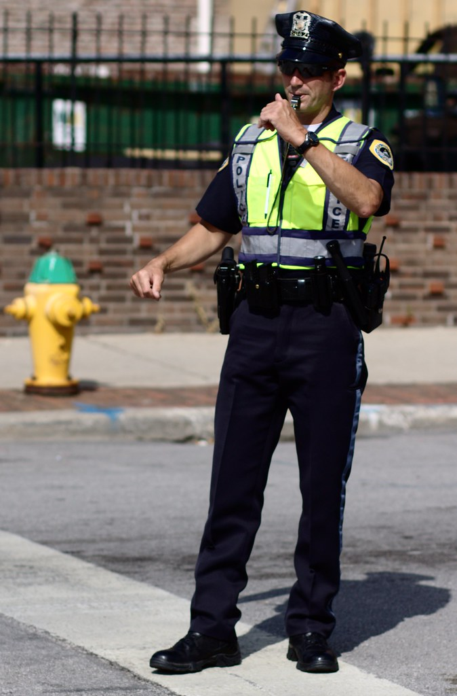

T r a f f i c C o p S p o t
Location
has
memory
H a p p y T e a c h i n g S p o t

Slide 23
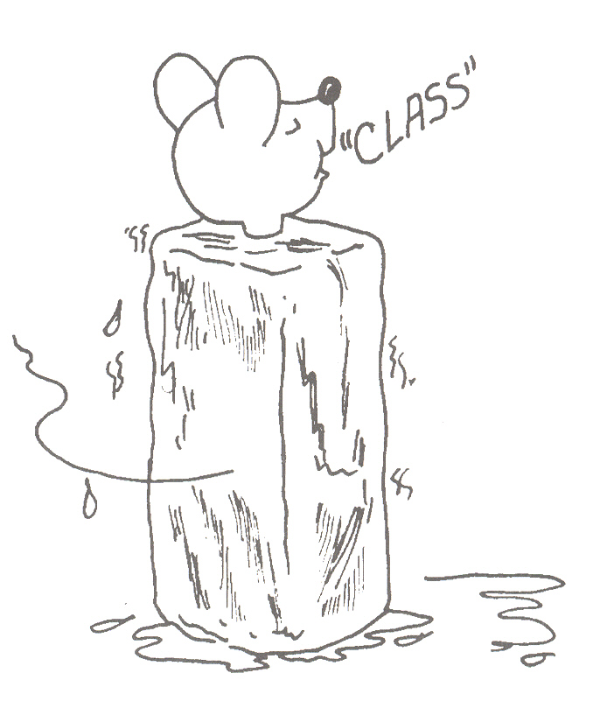

Freeze Body
Go to traffic cop spot (front of room)
Stand very still
Toes pointed straight ahead
Weight on both feet
Do a directed countdown
Frozen hand gesture
Verbal call to order: “Class” “Attention, please”

Slide 24
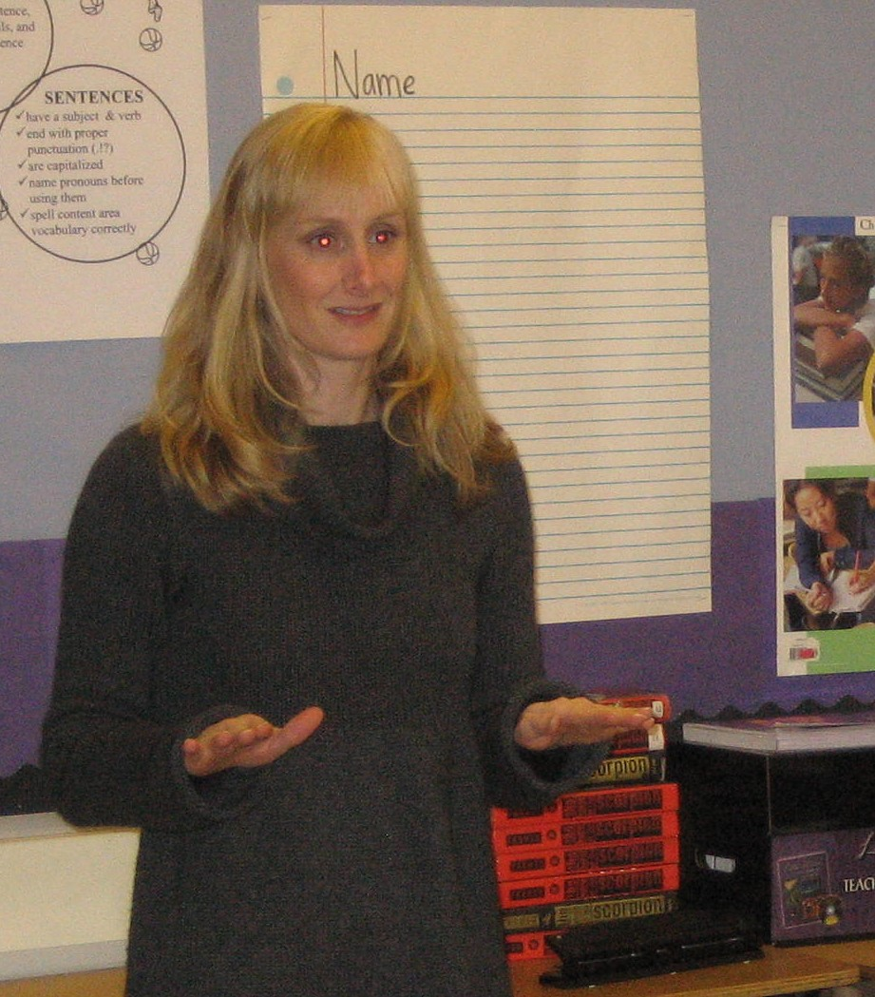
Frozen
Hand
Gestures

Slide 25
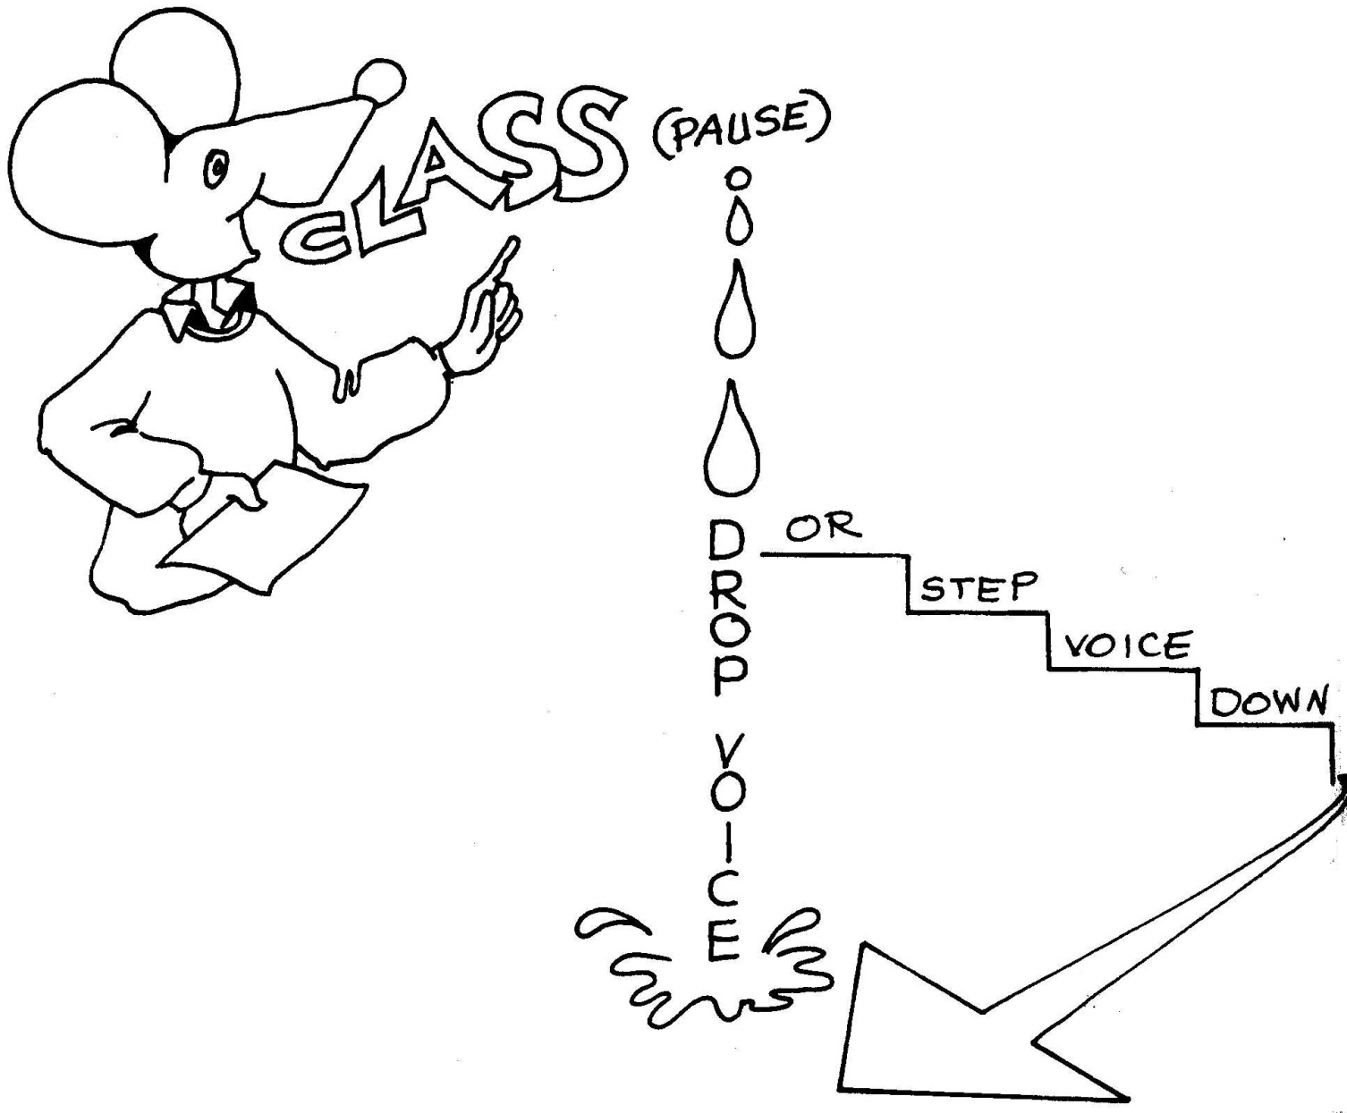
ABOVE (pause) Whisper

Slide 26


Slide 27

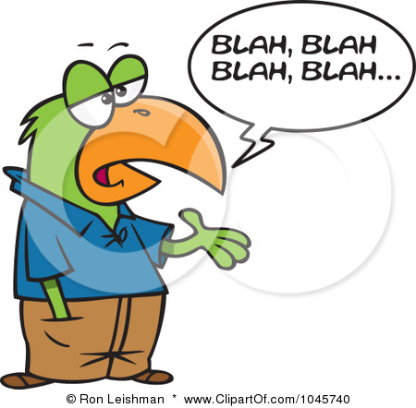
Who talks
when?

Slide 28
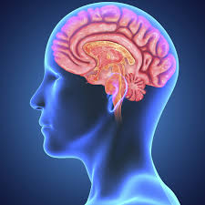
Blah blah blah
Blah blah blah blah ha ha ha ha ha
No Hands Raised =
The Blurt-a-thon
Blah blah blah blah ha ha ha ha ha
OUCH!

Slide 29

Who talks
when?
Hands Raised

Slide 30

My Turn!
Teacher Only One
Talking = TOOT

Slide 31

Transition to
Seatwork

Slide 32
Visual Exit Directions
Turn ‘n’ Talk
What would be the benefit of having written directions to seatwork?

Slide 33
Exit Directions
The teacher is the only one who knows
when only oral directions are used.
Oral Directions = Dependency
Visual Directions = Empowerment
  “If you have to say it twice,
  write it down.”
Notes:
33
Read through. Talk about the airport.

Slide 34
DO
What is the assignment? Be specific and prepared.
Where does it go when done?
When will time be up?
What do early finishers do?
DO
PUT
PUT
TIME
TIME
WHEN DONE

Slide 35
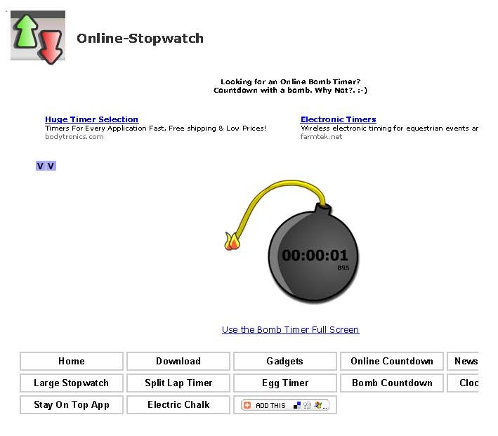
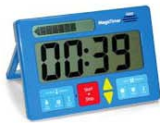
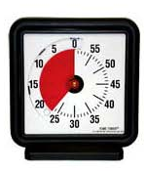
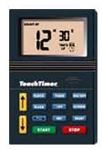
Teacher
Timers

Slide 36


Visual
Exit
Directions
ICONS

Slide 37



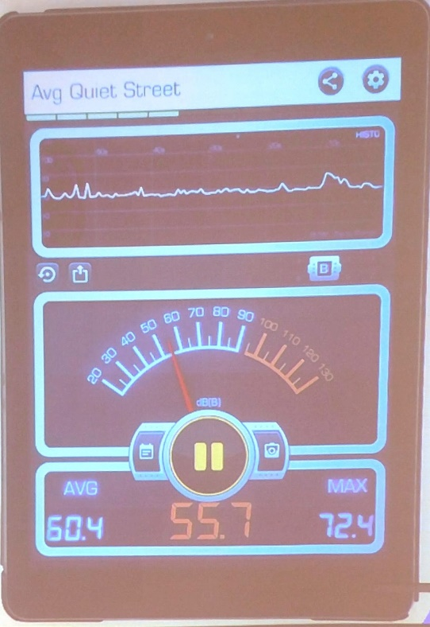
Voice
Level

Slide 38
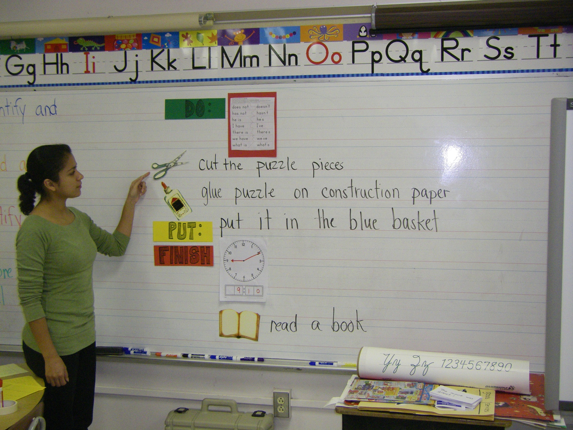

Slide 39
Directions
Open your book to pages 64-68
Look at the organisms.
Sort the organisms into TWO sets, based on the type of ecosystem where they might live.
Recorder/Reporter writes them on your dry-erase board.
Team Captain holds up your dry-erase board when the timer goes off, and facilitator shares your ideas.
You have 4 minutes

Slide 40
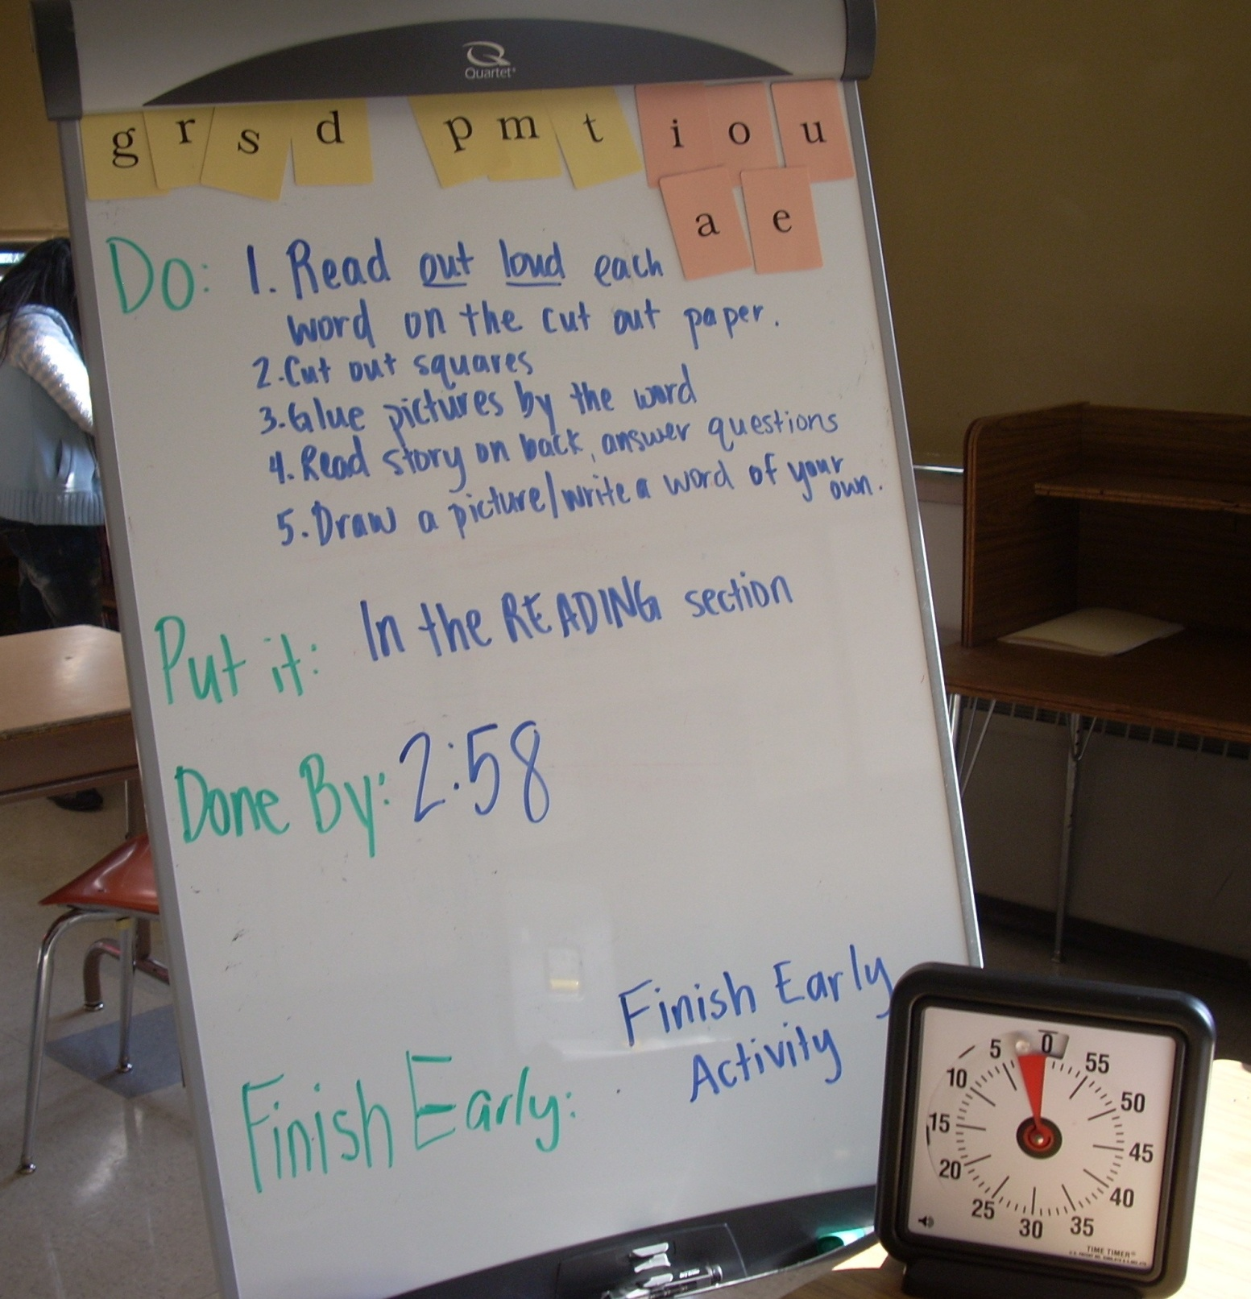

Slide 41
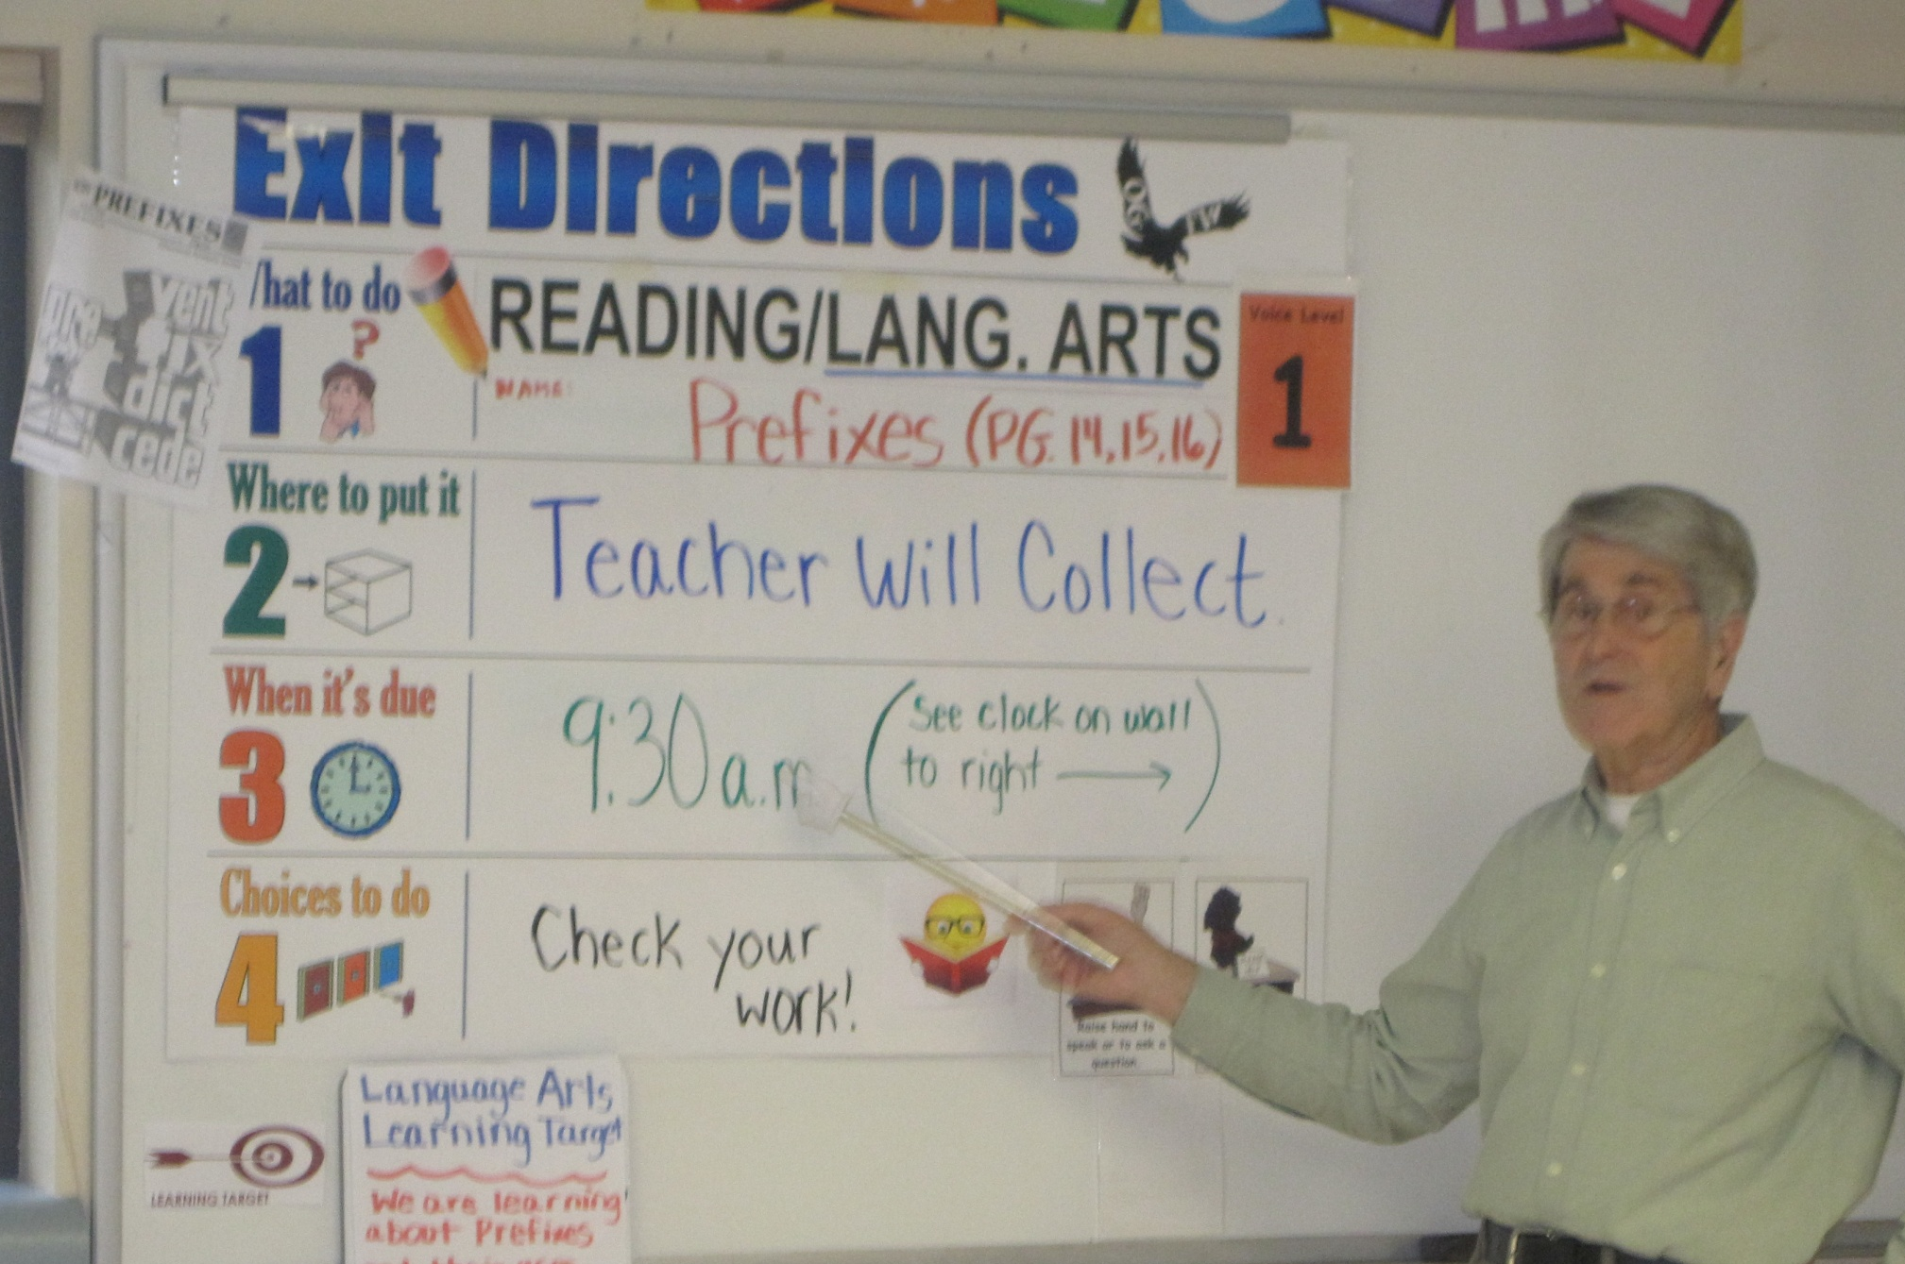

Slide 42
“I’m done…”
DO
What can students do when they are done with their seatwork? Enter your ideas:
https://docs.google.com/spreadsheets/d/1H1o5D4qSbfxAbAEV1-LAo1z2OdB4cZT9MC3xYLgEmNg/edit?usp=sharing
TIME
VOICE LEVEL
5 Minutes
WHEN DONE
Review today

Slide 43
M.I.T.S
Most
Important
Twenty
Seconds

Slide 44
M.I.T.S
“You may begin”
Do not move
Hands down
Then slowly…
Seconds

Slide 45
Exit Directions
Step 1:
Pass out all materials
Why?
REDUCE & PREVENT TRANSITIONS
Notes:
45
Read through. Talk about the airport.

Slide 46
Step 2: EXPLAIN THE ASSIGNMENT & ASK FOR QUESTIONS
DO
PUT
TIME
WHEN DONE

Slide 47
Influence
Approach

Slide 48

Acting out?
No eye contact.

Slide 49
Anger isn’t safe & doesn’t help
Sarcasm is not OK
Punishment doesn’t work
Demeaning students isn’t OK

Slide 50
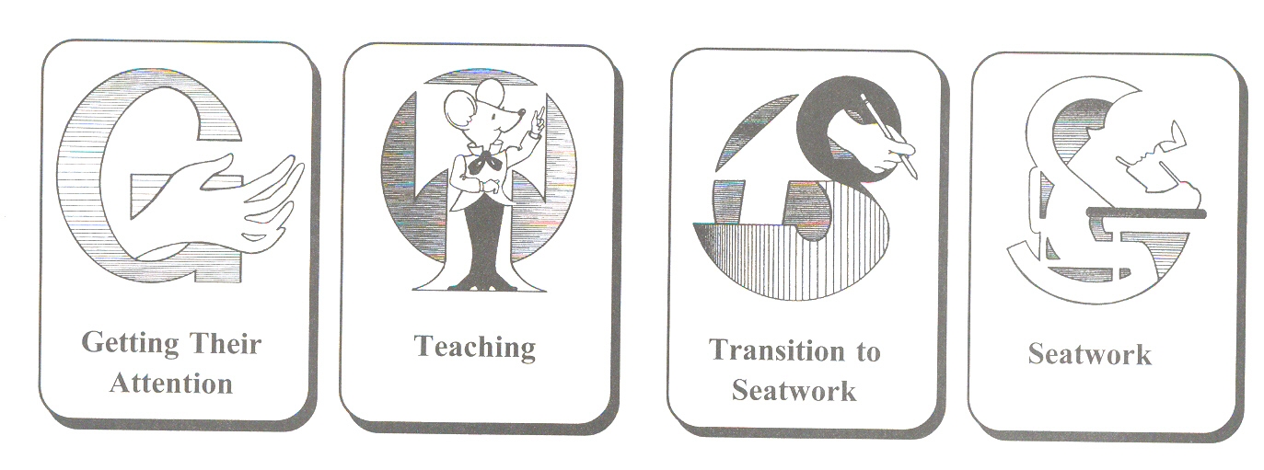
ENVoY
Finale

